Slide 1
Nucleotides and Nucleic Acids
Nucleotides
• “Energy rich” compounds
– Chemical signals
– Enzyme co-factors
*Nucleic Acids
– DNA and RNA
– Polymers of nucleotides
*3 components
– Nitrogenous “base”
– Ribose (or deoxyribose)
– Phosphate

Slide 2
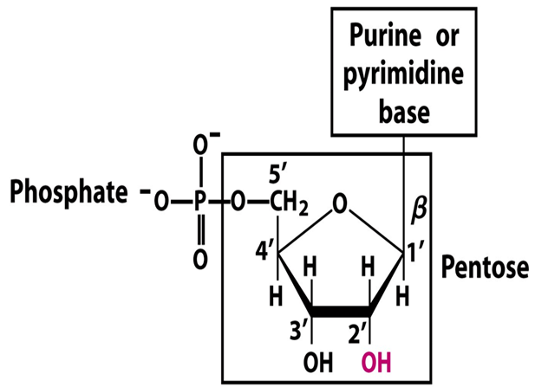

Slide 5
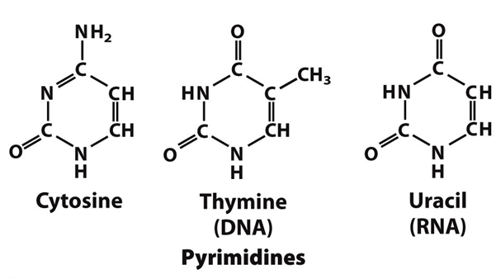

Slide 7
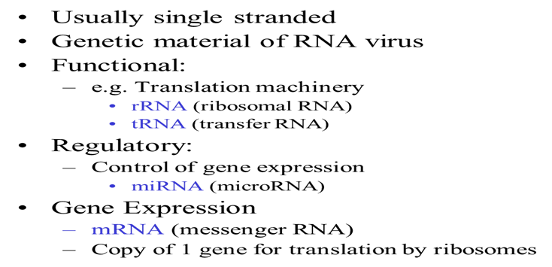

Slide 8
